Slide 1
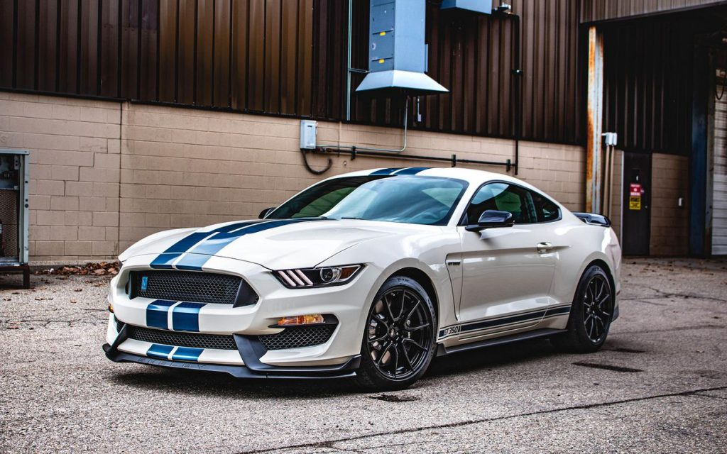
CAR SALES ANALYSIS

Slide 2

OVERVIEW
Business Problem
Analysis And Findings
Inventory Analysis
Total Cars By Status
Total Cars By Brand
Dealer Wise Inventory Breakdown
Price Trend Analysis
Top 10 Brands By Revenue
Average Price By Year
Average Price By Brand And Status
3. Insights And Recommendations

Slide 3
1. BUSINESS PROBLEM

Slide 4
BUSINESS PROBLEM
A leading car dealership is facing challenges in balancing inventory distribution and optimizing pricing strategies across new, used, and certified pre-owned cars. With fluctuating price trends and disproportionate inventory composition, the dealership seeks insights to improve inventory planning, price positioning, and ultimately boost profitability.

Slide 5
2. ANALYSIS & FINDINGS

Slide 6
I. INVENTORY ANALYSIS

Slide 7
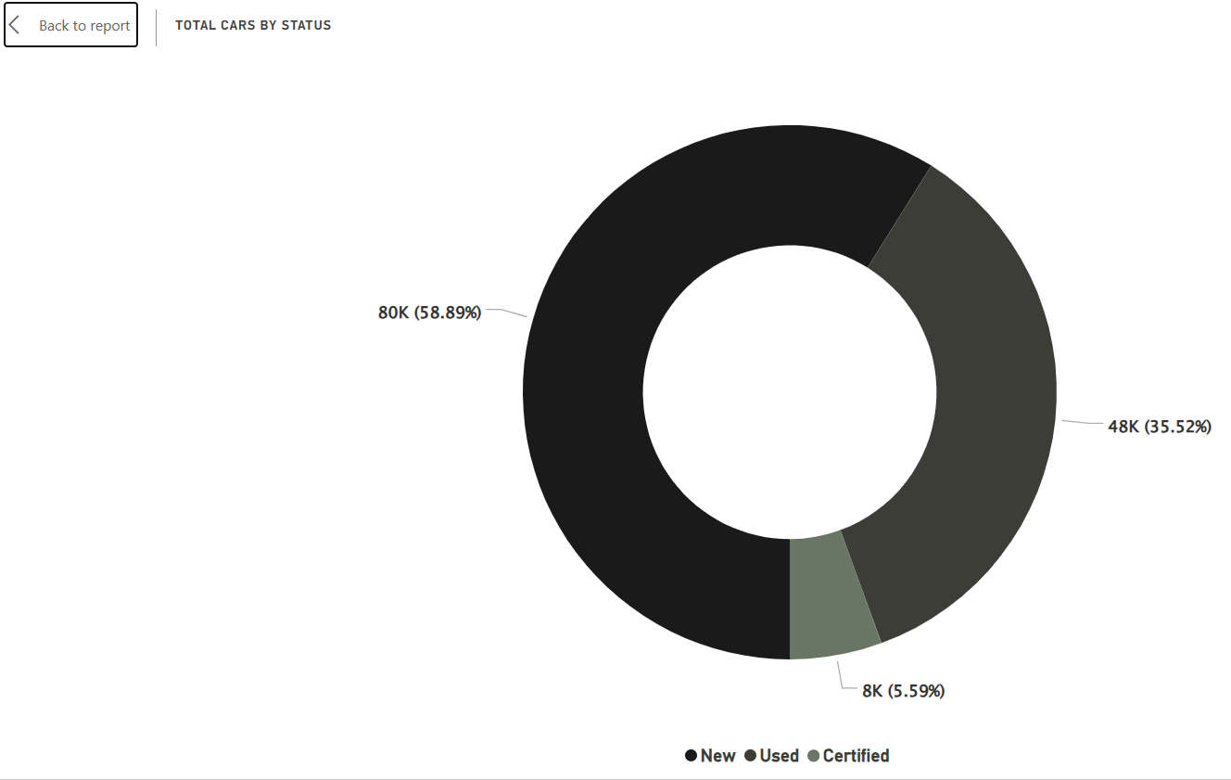
TOTAL CARS BY STATUS
This donut chart gives a clear summary of total cars by status
This donut chart visualizes the distribution of total vehicles across three categories: New (58.9%), Used (35.5%), and Certified (5.6%). The analysis highlights that new cars dominate the inventory with 80,000 units, followed by 48,000 used cars and 8,000 certified ones, helping dealerships prioritize stocking and marketing strategies accordingly.
Breakdown of Inventory
New: 80K vehicles, 58.89% of total inventory
Used: 48K vehicles, 35.52%
Certified: 8K vehicles , 5.59%

Slide 8
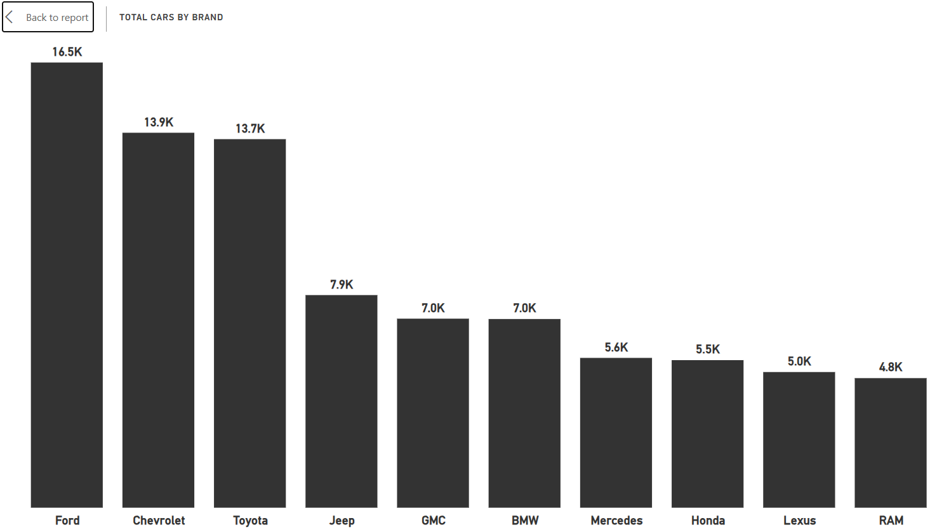
TOTAL CARS BY BRAND
The bar chart gives a clear summary of total cars by brand
Insights:
The inventory is heavily concentrated among three major brands: Ford (16.5K), Chevrolet (13.9K), and Toyota (13.7K).
These top 3 brands alone account for nearly 50%+ of the total stock.
Other brands like RAM, Lexus, and Honda are underrepresented.
Business Implication:
The brand skew could indicate market preference, dealership partnerships, or demand assumptions.
However, over-dependence on certain brands may lead to risks if market trends shift.

Slide 9
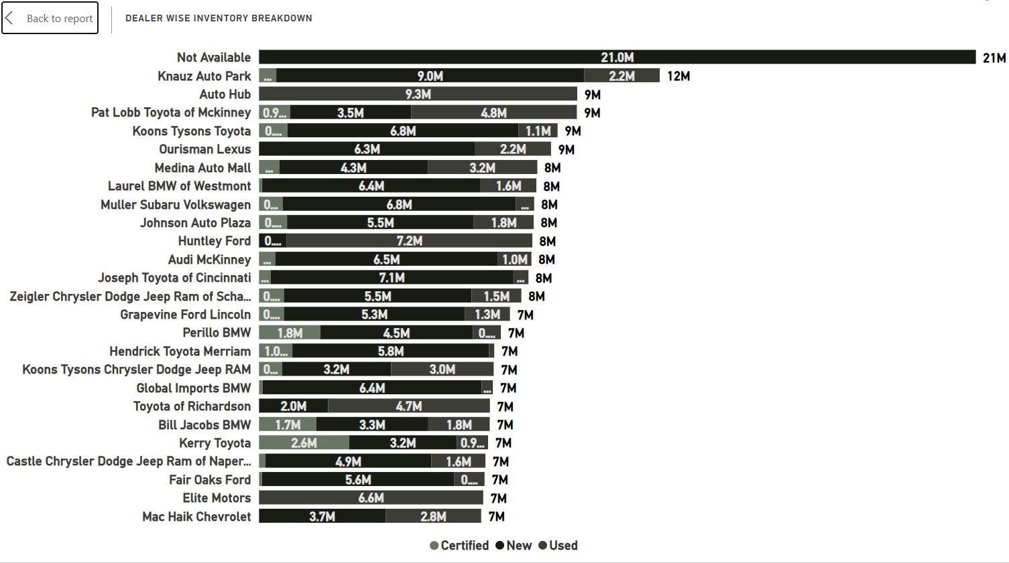
DEALER WISE INVENTORY BREAKDOWN
This stacked bar chart displays the total inventory value of each dealer.
The "Not Available" category leads with $21M, mostly in used cars.
Knauz Auto Park and Auto Hub follow closely with significant shares across all categories.
Key Insights
Highest Total Inventory:
Not Available tops the list with $21M in inventory
Knauz Auto Park has $12M, with a balanced split across all categories.
2. High Inventory Dealers:
Auto Hub, Pat Lobb Toyota of McKinney, Koons Tysons Toyota, and Ourisman Lexus all have ~$9M in inventory.
3. Lower Inventory Dealers:
Dealerships like Elite Motors, Fair Oaks Ford, and Castle Chrysler Dodge show around $7M inventory, still substantial but below the top performers.

Slide 10
II. PRICE TREND ANALYSIS

Slide 11
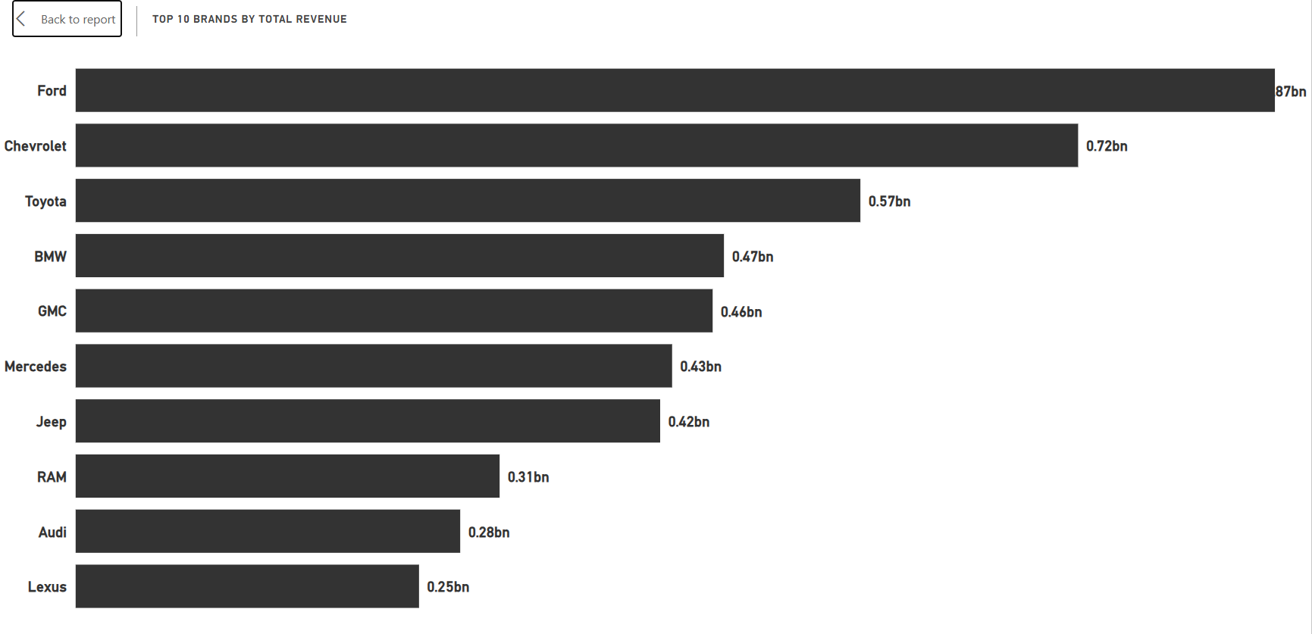
TOP 10 BRANDS BY REVENUE
This visualization ranks the top car brands based on total sales revenue.
Ford leads the market with 0.87 billion, followed by Chevrolet (0.72bn) and Toyota (0.57bn). Premium and luxury brands like BMW, Mercedes, and Audi also appear in the top 10, highlighting their strong market presence despite premium pricing.
Key Insights
Ford dominates with a total revenue of 0.87 billion, significantly higher than all other brands.
Strong performers: Chevrolet: 0.72bn , Toyota: 0.57bn
Mid-range brands: BMW (0.47bn), GMC (0.46bn), Mercedes (0.43bn), and Jeep (0.42bn) are close competitors in the mid-range category.
Lower tier: RAM (0.31bn), Audi (0.28bn), and Lexus (0.25bn) generate comparatively lower revenue but still rank among the top 10

Slide 12
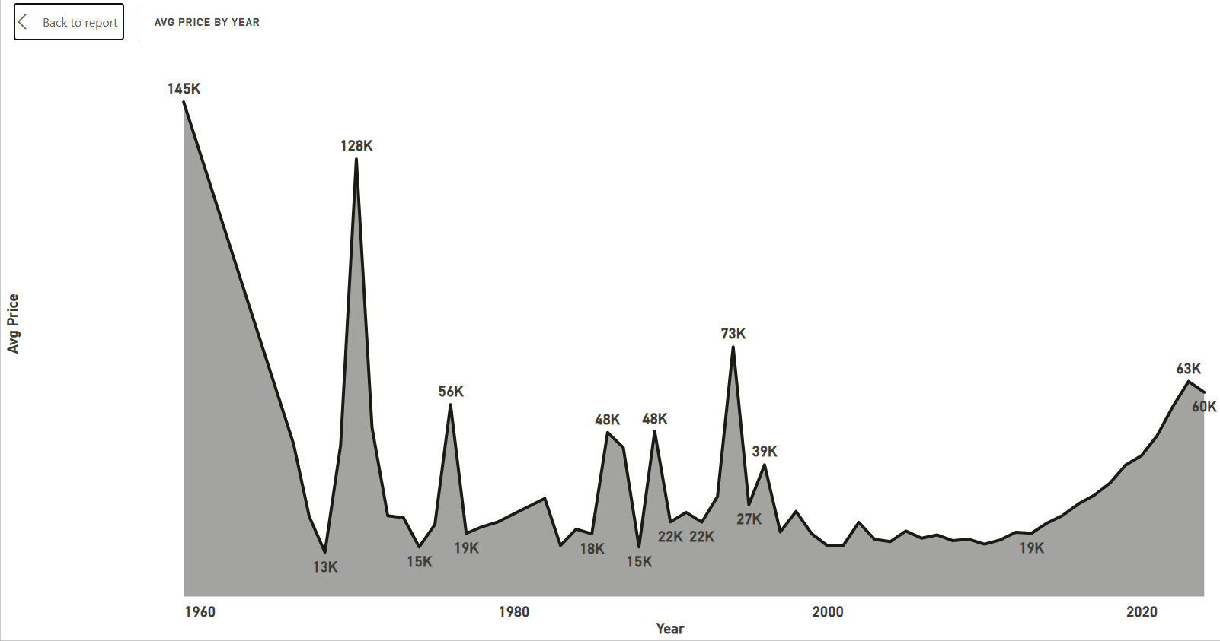
AVERAGE PRICE BY YEAR
This visualization highlights average car prices by year from 1960 to 2023.
The chart reveals significant pricing spikes in the 1960s and 70s, likely due to data outliers or rare luxury vehicles.
More consistent trends emerge post-1980, with a notable surge in prices after 2015. The recent increase reflects market inflation and growing demand for high-end or electric vehicles.
Key Insights
Extreme Peaks in Early Decades
1960: Sharp spike to 145K, followed by a dramatic drop to 13K.
1970: Another major jump to 128K, again followed by a steep fall.
These anomalies may be due to data outliers, limited entries, or luxury vehicles in those early years.
Stabilization After 1980
From 1980 onward, prices became more consistent, with values mostly ranging between 15K and 48K.
Minor peaks seen in 1983, 1987, 1995, and 1999
Since 2015, there's a steady upward trend in average car prices.
From a low of 19K, prices rose sharply to 63K in 2022, indicating increased demand, inflation, and possibly EV or luxury model influence.

Slide 13
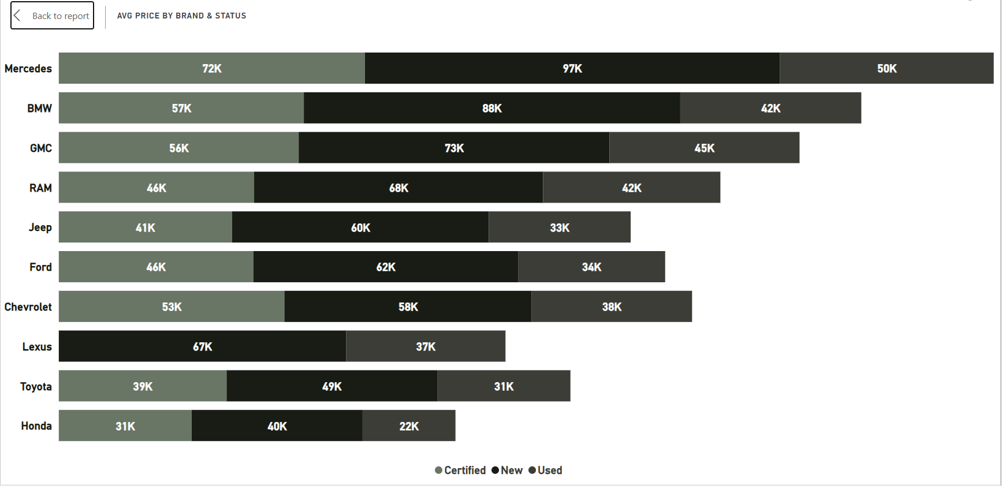
AVERAGE PRICE BY BRAND & STATUS
The analysis reveals premium pricing trends for brands like Mercedes and BMW, while also highlighting significant depreciation patterns from new to used vehicles.
This helps understand brand value perception and pricing strategy across the market segments.
Key Insights
Premium Brands Lead in Average Price
Mercedes has the highest average prices across all statuses: Certified: 72K, New: 97K, Used: 50K
BMW and Lexus follow closely, especially in Certified and New categories.
Price Drop from New to Used
All brands show a clear price reduction trend from New to Used, which is expected.
Lower Average Price Brands
Honda, Toyota, and Jeep represent more budget-friendly brands, with average prices below 50K in all categories.
Certified Cars Generally Priced Between New and Used
Certified prices often sit between New and Used, aligning with standard dealership pricing strategies.

Slide 14
3. INSIGHTS & RECOMMENDATIONS

Slide 15
INSIGHTS
1. Total Cars by Status
Used cars dominate the inventory, indicating strong resale market activity.
New cars follow next, while Certified cars make up the smallest portion.
2. Average Price by Status
New cars have the highest average price, as expected.
Certified cars are priced higher than used cars, reflecting added quality assurance and warranty.
Used cars are the most affordable, catering to budget-conscious buyers.
3. Top Brands by Total Sales Price
Brands like Toyota, Ford, and Chevrolet lead in total sales value.
These brands likely balance volume with value, showing a wide consumer base.
4. Yearly Price Trend by Car Status
A dramatic spike in new car prices (~1.9B) occurred around early 2020s, possibly due to supply chain issues or pandemic-related shortages.
Used car prices steadily increased, reaching around 0.20B, highlighting strong demand in the second-hand market.
Certified car prices remained consistently low, peaking only at 0.05B, suggesting limited market penetration.

Slide 16
RECOMMENDATIONS
For Dealerships:
Increase focus on used car inventory, as it holds the majority market share and steady price growth.
Promote certified cars more aggressively—they offer better margins than used cars and attract trust-focused buyers.
For Buyers:
If budget-conscious, the used car segment remains the best value proposition.
Buyers seeking reliability and warranties at a lower price than new cars should consider certified pre-owned vehicles.
For Manufacturers:
Monitor the volatility in new car pricing—ensure production and supply chain stability to avoid future price spikes.
Develop more certification programs to boost the certified car market share and profitability.

Slide 17
THANK YOU

